Slide 1


CHOIR
Welcome Back!

Slide 2


Sing well
Express yourself
Share our talent
Build Confidence
Self Esteem
Listen, don’t talk over anyone
Respect other opinions
Support each other
Make new friends
Be Unique
Being inclusive
Supporting each other
Teamwork
Listening Skills
HAVE FUN!!!!
Keep Focussed
Try your best!
More community work
Public Performances
Seeing new places
More Feedback
Respect Boundaries
Don’t pop anybody's bubble
Talk to the Choir team with any questions concerns
CHOIR

Slide 3
Welcome Back!
Born This Way
Something Inside
Stand by me
All About You
Three Little Birds/One Love
Shotgun
A Little Respect
Lean On Me
Tender
Unwritten

Slide 4
Stand By Me
When the night has come
And the land is dark
And the moon is the only light we'll see
No, I won't be afraid
No, I won't be afraid
Just as long as you stand
Stand by me
So darlin', darlin', stand by me
Oh, stand by me
Oh, stand
Stand by me, stand by me
If the sky that we look upon
Should tumble and fall
Or the mountains should crumble to the sea
I won't cry, I won't cry
No I won't shed a tear
Just as long as you stand
Stand by me

Slide 5
Stand By Me
And darlin', darlin', stand by me
Oh, stand by me
Oh, stand now
Stand by me, stand by me
And darlin', darlin', stand by me
Oh, stand by me
Oh, stand now
Stand by me, stand by me
Whenever you're in trouble won't you stand by me
Oh, stand by me
Won't you stand by

Slide 6
Our Repertoire
A Little Respect
Born This Way
All About You
Make Your Own Kind Of Music
Lean On Me
Tender
Something Inside
California Dreaming
Love My Life
Mean
Electric Dreams
Mountain
Wonder
Three Little Birds/One Love
Shotgun
Aint No Mountain High Enough
Stand By Me

Slide 7

2024
Something Inside
All About You
Three Little Birds/One Love
Love My Life
Merry Xmas (Slade) 15mins
A Little Respect
Lean On Me
Tender
Christmas Song? Silent Night?

Slide 8
VOCAL PERCUSSION
Itsy Bitsy Itsy Bitsy Itsy Bitsy Ditsy Hippopotamus
Barbie-Q-Ken-and Barbie-Q
Chuck a Chop of Chicken or Chop Chipotle Chili Up
Finale
Notes:
Also: http://www.youtube.com/watch?v=Ghj977-IiPI

Slide 9
Thank You for the Music
I'm nothing special, in fact I'm a bit of a bore
If I tell a joke, you've probably heard it before
But I have a talent, a wonderful thing
'Cause everyone listens when I start to sing
I'm so grateful and proud
All I want is to sing it out loud
So I say thank you for the music, the songs I'm singing
Thanks for all the joy they're bringing
Who can live without it?
I ask in all honesty
What would life be?
Without a song or a dance, what are we?
So I say thank you for the music, for giving it to me

Slide 10
Thank You for the Music
Mother says I was a dancer before I could walk
Mhm, she says I began to sing long before I could talk
And I've often wondered, how did it all start?
Who found out that nothing can capture a heart like a melody can?
Well, whoever it was, I'm a fan
So I say thank you for the music, the songs I'm singing
Thanks for all the joy they're bringing
Who can live without it?
I ask in all honesty
What would life be?
Without a song or a dance, what are we?
So I say thank you for the music, for giving it to me

Slide 11
Thank You for the Music
I've been so lucky
I am the girl with golden hair
I wanna sing it out to everybody
What a joy, what a life, what a chance
Thank you for the music, the songs I'm singing
Thanks for all the joy they're bringing
Who can live without it?
I ask in all honesty
What would life be?
Without a song or a dance, what are we?
So I say thank you for the music, for giving it to me

Slide 12
Make Your Own Kind of Music
Nobody can tell ya
There's only one song worth singin'
They may try and sell ya
'Cause it hangs them up
To see someone like you
But you've gotta make your own kind of music
Sing your own special song
Make your own kind of music
Even if nobody else sings along

Slide 13
Make Your Own Kind of Music
You're gonna be nowhere,
The loneliest kind of lonely
It may be rough goin'
Just to do your thing
The hardest thing to do
But you've gotta make your own kind of music
Sing your own special song
Make your own kind of music
Even if nobody else sings along

Slide 14
Make Your Own Kind of Music
So if you cannot take my hand
And if you must be goin'
I will understand
You gotta make your own kind of music
Sing your own special song
Make your own kind of music
Even if nobody else sings along
You gotta make your own kind of music
Sing your own special song,
Make your own kind of music even if nobody
Else sings along.

Slide 15
Unwritten 🌵
I am unwritten
Can't read my mind
I'm undefined
I'm just beginning
The pen's in my hand
Ending unplanned
Staring at the blank page before you
Open up the dirty window
Let the sun illuminate the words
That you could not find
🌵

Slide 16
Unwritten
Reaching for something in the distance
So close you can almost taste it
Release your inhibitions
Feel the rain on your skin
No one else can feel it for you
Only you can let it in
No one else, no one else
Can speak the words on your lips
Drench yourself in words unspoken
Live your life with arms wide open
Today is where your book begins
The rest is still unwritten

Slide 17
Unwritten
Oh, oh
I break tradition
Sometimes my tries
Are outside the lines
We've been conditioned
To not make mistakes
**But I can't live that way, no
Staring at the blank page before you
Open up the dirty window
Let the sun illuminate the words
That you could not find

Slide 18
Unwritten
Reaching for something in the distance
So close you can almost taste it
Release your inhibitions
Feel the rain on your skin
No one else can feel it for you
Only you can let it in
No one else, no one else
Can speak the words on your lips
Drench yourself in words unspoken
Live your life with arms wide open
To the years where your book begins
Feel the rain on your skin
No one else can feel it for you
Only you can let it in
No one else, no one else
Can speak the words on your lips

Slide 19
Unwritten
Drench yourself in words unspoken
Live your life with arms wide open
To the years where your book begins
The rest is still unwritten
Staring at the blank page before you
Open up the dirty window
Let the sun illuminate the words
That you could not find

Slide 20
Unwritten
Reaching for something in the distance
So close you can almost taste it
Release your inhibitions
Feel the rain on your skin
No one else can feel it for you
Only you can let it in
No one else, no one else
Can speak the words on your lips
Drench yourself in words unspoken
Live your life with arms wide open
To the years where your book begins
Feel the rain on your skin

Slide 21
Unwritten
No one else can feel it for you
Only you can let it in
No one else, no one else
Can speak the words on your lips
Drench yourself in words unspoken
Live your life with arms wide open
To the years where your book begins
The rest is still unwritten
The rest is still unwritten
The rest is still unwritten

Slide 22
Believe
No matter how hard I try
You keep pushing me aside
And I can't break through
There's no talking to you
It's so sad that you're leaving
It takes time to believe it
But after all is said and done
You're gonna be the lonely one
Oh, oh
Do you believe in life after love?
I can feel something inside me say
"I really don't think you're strong enough. No."
Do you believe in life after love?
I can feel something inside me say
"I really don't think you're strong enough. No."

Slide 23
Believe
What am I supposed to do?
Sit around and wait for you?
Well, I can't do that
And there's no turning back
I need time to move on
I need love to feel strong
'Cause I've had time to think it through
And maybe I'm too good for you
Oh, oh
Do you believe in life after love?
I can feel something inside me say
"I really don't think you're strong enough. No."
Do you believe in life after love?
I can feel something inside me say
"I really don't think you're strong enough. No."

Slide 24
Believe
Well, I know that I'll get through this
'Cause I know that I am strong
And I don't need you anymore
Oh, I don't need you anymore
Oh, I don't need you anymore
No, I don't need you anymore
Do you believe in life after love?
I can feel something inside me say
"I really don't think you're strong enough. No."
Do you believe in life after love?
I can feel something inside me say
"I really don't think you're strong enough. No."
(X2)

Slide 25
Use Somebody
I've been roaming around
Always looking down at all I see
Painted faces fill the places I can't reach
You know that I could use somebody
You know that I could use somebody
Someone like you, and all you know, and how you speak
Countless lovers under cover of the street
You know that I could use somebody
You know that I could use somebody
Someone like you
Someone like you
Someone like you

Slide 26
Use Somebody
Off in the night, while you live it up, I'm off to sleep
Waging wars to shape the poet and the beat
I hope it's gonna make you noticе
I hope it's gonna make you notice
Somеone like me
Someone like me
Someone like me, somebody
I'm ready now (x7)
Someone like you
Someone like you
Someone like you

Slide 27
Use Somebody
Someone like you
Somebody
Someone like you
Somebody
Someone like you
Somebody
I've been roamin' around, always lookin' down at all I see

Slide 28
(Something Inside) So Strong
The higher you build your barriers
The taller I become
The further you take my rights away
The faster I will run
You can deny me
You can decide
…To turn your face away……1 2 3 4 1 no matter 'cause there’s
Something inside so strong
I know that I can make it
Though you're doing me wrong, so wrong
you thought that my pride was gone (Oh no)
Something inside so strong
Oh something inside so strong

Slide 29
(Something Inside) So Strong
The more you refuse to hear my voice
Oh way Oh way Oh way Oh way……
The louder I will sing
You hide behind walls of Jericho
Oh way Oh way Oh way Oh way….
And your lies will come tumbling
Deny my place in time
You squander wealth that's mine
My light will shine so brightly
It will blind you
Cos there’s …

Slide 30
(Something Inside) So Strong
Something inside so strong (so strong)
I know that I can make it
Though you're doing me wrong, so wrong
Oh, you thought that my pride was gone
There's something inside so strong
Oh there's something inside so strong
Brothers and sisters!
When they insist we're just not good enough
When we know better
Just look 'em in the eye and say
We're gonna do it anyway
We're gonna do it anyway

Slide 31
(Something Inside) So Strong
Because there's
Something inside so strong
I know that I can make it
Though you're doing me wrong, so wrong
You thought that my pride was gone, Oh no
Something inside so strong!
Something inside so strong
I know that I can make it
Though you're doing me wrong, so wrong
You thought that my pride was gone, Oh no
Something inside so strong, Oh - oh oh oh oh oh
Something inside so strong, Oh - oh oh oh oh oh
Something inside so strong, Oh - oh oh oh oh oh
Something insi – de... so... stro – ng!

Slide 32
Lean On Me
Sometimes in our lives
We all have pain, we all have sorrow
But if we are wise
We know that there's always tomorrow
Lean on me when you're not strong
And I'll be your friend, I'll help you carry on
For it won't be long
'Til I'm gonna need somebody to lean on
Please swallow your pride
If I have things you need to borrow
For no one can fill those of your needs
That you won't let show

Slide 33
You just call on me, brother, when you need a hand
We all need somebody to lean on
I just might have a problem that you'll understand
We all need somebody to lean on
Lean on me when you're not strong
And I'll be your friend, I'll help you carry on
For it won't be long
'Til I'm gonna need somebody to lean on
You just call on me, sister, when you need a hand
We all need somebody to lean on
I just might have a problem that you'll understand
We all need somebody to lean on

Slide 34
If there is a load
You have to bear
That you can't carry
I'm right up the road
I'll share your load
If you just call me
call me
call me
call me
call…. me….

Slide 35
Born This Way
My mama told me when I was young, we are all born superstars
She rolled my hair and put my lipstick on, in the glass of her boudoir
There's nothing wrong with loving who you are she said
cause He made you perfect, baby
So hold your head up and you'll go far
Listen to me when I say
I'm beautiful in my way
cause God makes no mistakes
I'm on the right track baby I was born this way
Don't hide yourself in regret, just love yourself and you're set
I'm on the right track baby I was born this way

Slide 36
Ooh, there ain't no other way, baby I was born this way
Baby I was born this way
Ooh, there ain't no other way, baby I was born this way
Right track baby I was born this way
Break
Don't be a drag just be a queen
Whether you're broke or evergreen
You're black, white, beige chola descent
You're Lebanese you're Orient
Whether life's disabilities left you outcast bullied or teased
Rejoice and love yourself today
Cause baby you were born this way

Slide 37
Break
No matter gay straight or bi, lesbian transgender life
I'm on the right track baby I was born to survive
No matter black white or beige chola or Orient made
I'm on the right track baby I was born to be brave
I'm beautiful in my way cause God makes no mistakes
I'm on the right track baby I was born this way
Don't hide yourself in regret, just love yourself and you're set
I'm on the right track baby I was born this way

Slide 38
Break
Ooh, there ain't no other way, baby I was born this way
Baby I was born this way
Ooh, there ain't no other way, baby I was born this way
Baby I was born this way
I was born this way, hey
I was born this way, hey
I'm on the right track baby I was born this way, hey
I was born this way, hey
I was born this way, hey
I'm on the right track baby I was born this way!

Slide 39
Love My Life
Tether your soul to me
I will never let go completely
One day your hands will be
Strong enough to hold me
I might not be there for all your battles
But you'll win them eventually
I pray that I'm giving you all that matters
So one day you'll say to me
"I love my life
I am powerful, I am beautiful, I am free
I love my life
I am wonderful, I am magical, I am me
I love my life."

Slide 40
Love My Life
I am not my mistakes
And God knows, I've made a few
I started to question the angels
And the answer they gave was you
I cannot promise there won't be sadness
I wish I could take it from you
But you'll find the courage to face the madness
And sing it because it's true
I love my life
I am powerful, I am beautiful, I am free
I love my life
I am wonderful, I am magical, I am me
I love my life

Slide 41
Love My Life
Find the others with hearts like yours
Run far, run free. I'm with you
I love my life
I am powerful, I am beautiful, I am free
I love my life
I am wonderful, I am magical, I am me
I love my life
I am powerful, I am beautiful, I am free
I love my life
I am wonderful, I am magical, I am me
I love my life
And finally
I'm where I wannnnnnnnt (3 beats)
To be

Slide 42
All About You
It's all about you (It's about you)
It's all about you, baby (It's all about)
It's all about you (It's about you)
It's all about you
Yesterday you asked me something I thought you knew
So I told you with a smile, it's all about you
Then you whispered in my ear and you told me too
Said you'd make my life worthwhile, it's all about you
And I would answer all your wishes
If you ask me to
But if you deny me one of your kisses
Don't know what I'd do

Slide 43
All About You
So hold me close and say three words
Like you used to do
Dancing on the kitchen tiles
It's all about you, yeah
And I would answer all your wishes
If you ask me to
But if you deny me one of your kisses
Don't know what I'd do…. So…
hold me close and say three words
Like you used to do
Dancing on the kitchen tiles
Yes, you make my life worthwhile
So I told you with a smile, it's all about you

Slide 44
All About You
It's all about you (It's about you)
It's all about you, baby (It's all about)
It's all about you (It's about you)
It's all about you, baby (It's all about)
It's all about you

Slide 45
Make Your Own Kind of Music
Nobody can tell ya
There's only one song worth singin'
They may try and sell ya
'Cause it hangs them up
To see someone like you
But you've gotta make your own kind of music
Sing your own special song
Make your own kind of music
Even if nobody else sings along

Slide 46
Make Your Own Kind of Music
You're gonna be nowhere,
The loneliest kind of lonely
It may be rough goin'
Just to do your thing
The hardest thing to do
But you've gotta make your own kind of music
Sing your own special song
Make your own kind of music
Even if nobody else sings along

Slide 47
Make Your Own Kind of Music
So if you cannot take my hand
And if you must be goin'
I will understand
You gotta make your own kind of music
Sing your own special song
Make your own kind of music
Even if nobody else sings along
You gotta make your own kind of music
Sing your own special song,
Make your own kind of music even if nobody
Else sings along.

Slide 48
A Little Respect
I try to discover
A little something to make me sweeter
Oh baby refrain from breaking my heart
I'm so in love with you
I'll be forever blue
That you give me no reason
Why you're making me work so hard
That you give me no
That you give me no
That you give me no
That you give me no
Soul, I hear you calling
Oh baby please give a little respect to me

Slide 49
A Little Respect
And if I should falter
Would you open your arms out to me
We can make love not war, And live at peace with our hearts
I'm so in love with you
I'll be forever blue
What religion or reason
Could drive a man to forsake his lover
Don't you tell me no
Don't you tell me no
Don't you tell me no
Don't you tell me no
Soul, I hear you calling
Oh baby please give a little respect to me...
Soul... (x3)

Slide 50
Lean On Me
Sometimes in our lives
We all have pain, we all have sorrow
But if we are wise
We know that there's always tomorrow
Lean on me when you're not strong
And I'll be your friend, I'll help you carry on
For it won't be long
'Til I'm gonna need somebody to lean on
Please swallow your pride
If I have things you need to borrow
For no one can fill those of your needs
That you won't let show

Slide 51
Lean On Me
You just call on me, brother, when you need a hand
We all need somebody to lean on
I just might have a problem that you'll understand
We all need somebody to lean on
Lean on me when you're not strong
And I'll be your friend, I'll help you carry on
For it won't be long
'Til I'm gonna need somebody to lean on
You just call on me, sister, when you need a hand
We all need somebody to lean on
I just might have a problem that you'll understand
We all need somebody to lean on

Slide 52
Lean On Me
If there is a load
You have to bear
That you can't carry
I'm right up the road
I'll share your load
If you just call me
call me
call me
call me
call.... me....

Slide 53
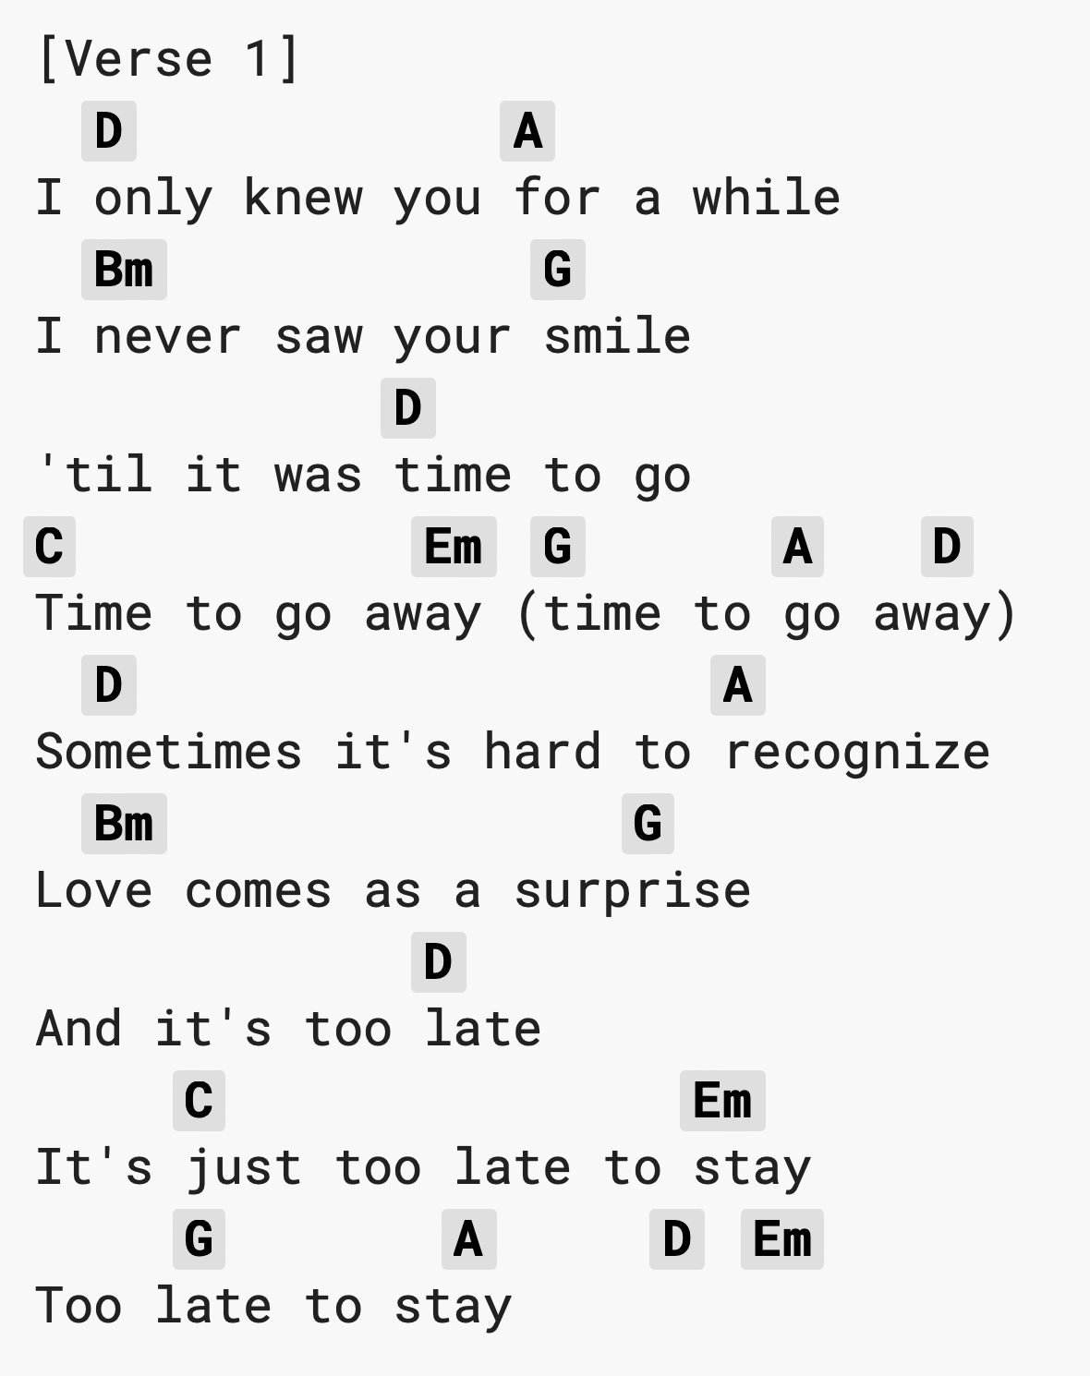
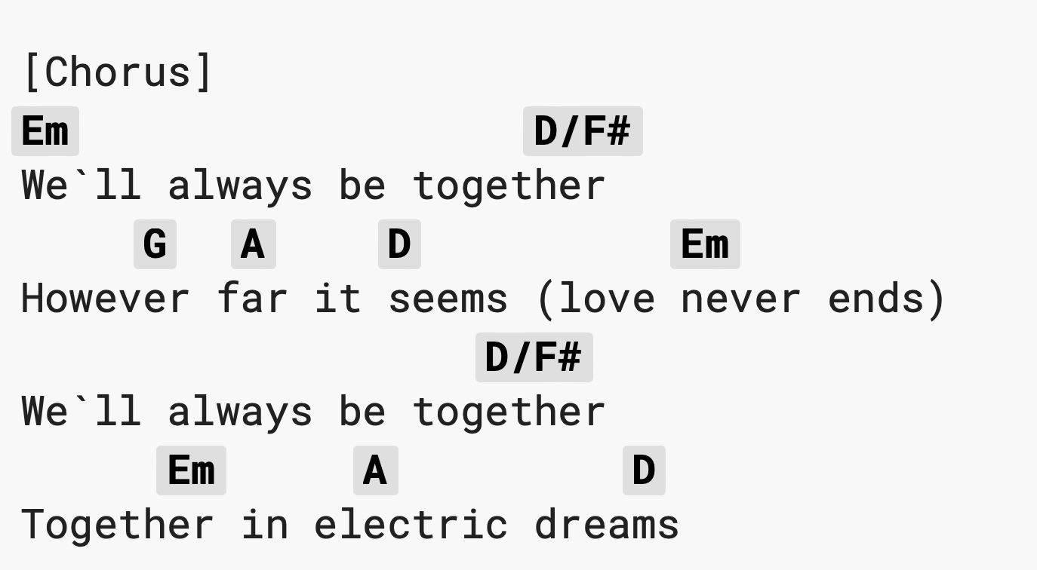

Slide 54
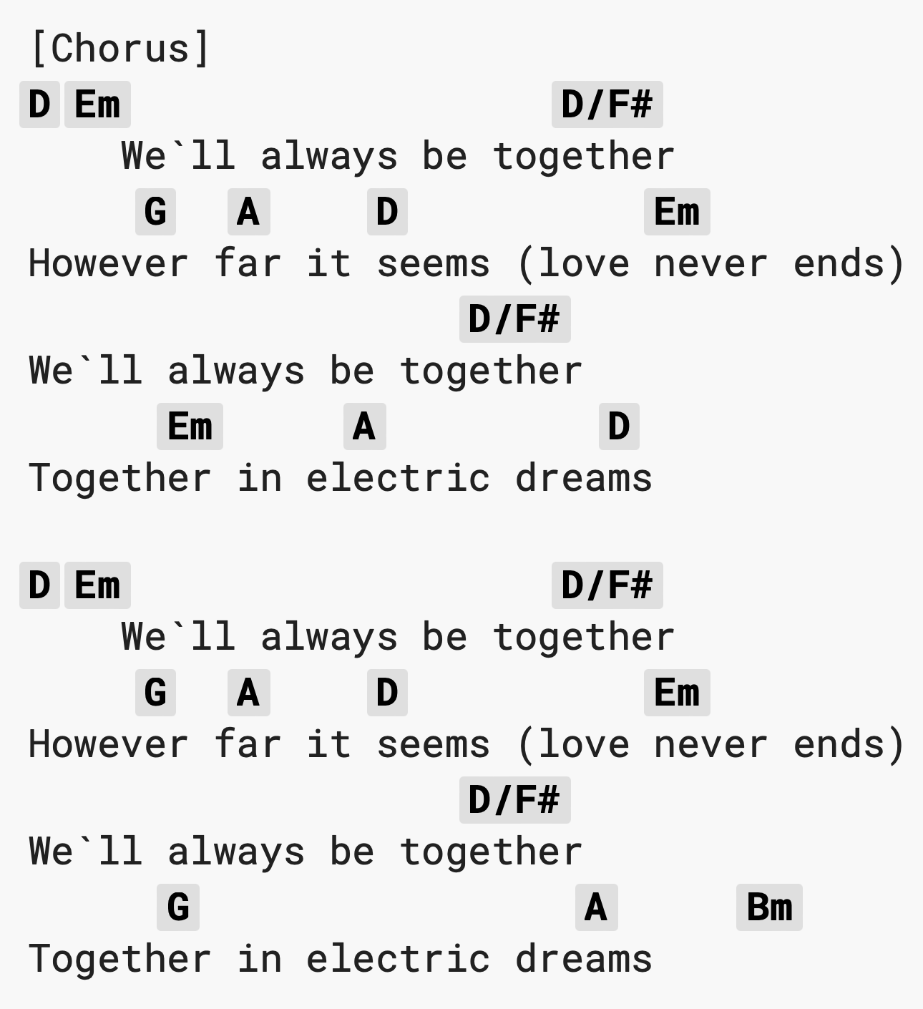
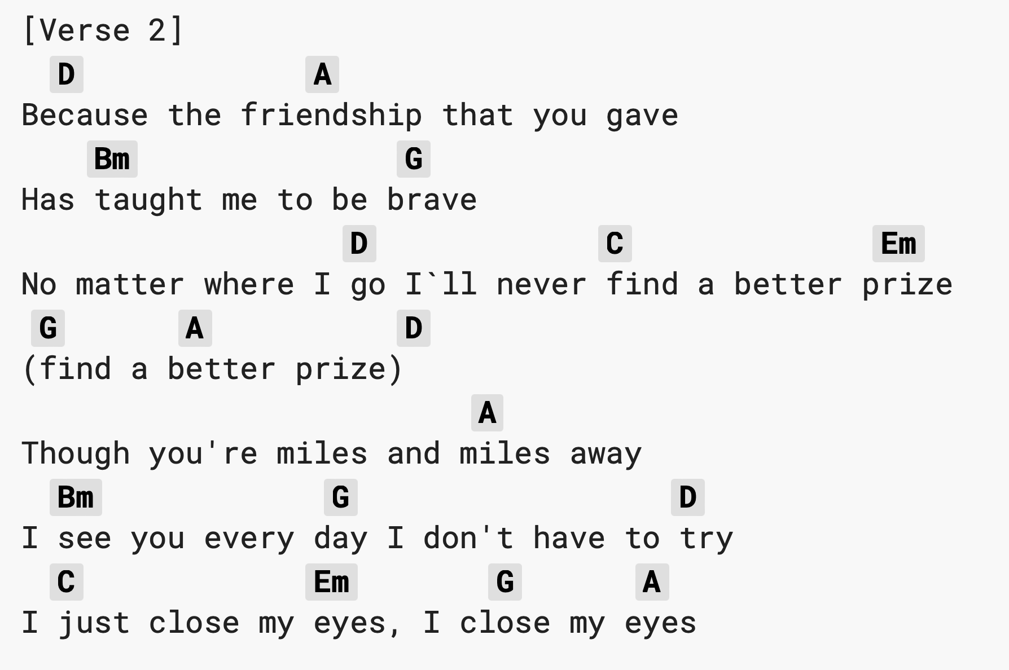

Slide 55
California Dreaming
All the leaves are brown (All the leaves are brown)
and the sky is gray (and the sky is gray)
I've been for a walk (I've been for a walk)
on a winter's day (on a winter's day)
I'd be safe and warm (I'd be safe and warm)
if I was in L.A. (if I was in L.A.)
California dreamin' on such a winter's day
Stopped in to a church I passed along the way
Well I got down on my knees (got down on my knees)
and I pretend to pray (I pretend to pray)
You know the preacher lights the coals (preacher lights the coals)
He knows I'm gonna stay (knows I'm gonna stay)
California dreamin' on such a winter's day

Slide 56
California Dreaming
Instrumental

Slide 57
California Dreaming
All the leaves are brown and the sky is gray
I've been for a walk on a winter's day
If I didn't tell her I could leave today
California…
dreamin’ (on such a winter's day)
dreamin’ (on such a winter's day)
dreamin’ (on such a winter's day)
dreamin’ (on such a winter's day)
dreamin’ (on such a winter's day)
Notes:
Change balack and red

Slide 58
Tender
Tender is the night
Lying by your side
Tender is the touch
Of someone that you love too much
Tender is the day
The demons go away
Lord I need to find
Someone who can heal my mind
Come on, come on, come on
Get through it
Come on, come on, come on
Love's the greatest thing
Come on, come on, come on
Get through it
Come on, come on, come on
Love's the greatest thing
That we have
I'm waiting for that feeling
I'm waiting for that feeling
Waiting for that feeling to come
Oh my baby
Oh my baby
Oh why
Oh my
Oh my baby
Oh my baby
Oh why
Oh my

Slide 59
Tender
Tender is the ghost
The ghost I love the most
Hiding from the sun
Waiting for the night to come
Tender is my heart
I'm screwing up my life
Lord I need to find
Someone who can heal my mind
Come on, come on, come on
Get through it
Come on, come on, come on
Love's the greatest thing
Come on, come on, come on
Get through it
Come on, come on, come on
Love's the greatest thing
That we have
I'm waiting for that feeling
I'm waiting for that feeling
Waiting for that feeling to come
Oh my baby
Oh my baby
Oh why
Oh my
Oh my baby
Oh my baby
Oh why
Oh my

Slide 60
Tender
Come on, come on, come on
Get through it
Come on, come on, come on
Love's the greatest thing
Come on, come on, come on
Get through it
Come on, come on, come on
Love's the greatest thing
That we have
I'm waiting for that feeling
I'm waiting for that feeling
Waiting for that feeling to come
Oh my baby
Oh my baby
Oh why
Oh my
Oh my baby
Oh my baby
Oh why
Oh my

Slide 61
Mean
You, with your words like knives
And swords and weapons that you use against me
You have knocked me off my feet again
Got me feeling like I'm nothing
You, with your voice like nails on a chalkboard
Calling me out when I'm wounded
You, picking on the weaker man
Well, you can take me down
With just one single blow
But you don't know what you don't know
Someday, I'll be living in a big old city
And all you're ever gonna be is mean
Someday, I'll be big enough so you can't hit me
And all you're ever gonna be is mean
Why you gotta be so mean?

Slide 62
Mean
You, with your switching sides
And your wildfire lies and your humiliation
You have pointed out my flaws again
As if I don't already see them
I walk with my head down, trying to block you out
'Cause I'll never impress you
I just wanna feel okay again
I bet you got pushed around
Somebody made you cold
But the cycle ends right now
'Cause you can't lead me down that road
And you don't know what you don't know
Someday, I'll be living in a big old city
And all you're ever gonna be is mean
Someday, I'll be big enough so you can't hit me
And all you're ever gonna be is mean
Why you gotta be so mean?

Slide 63
Mean
And I can see you years from now in a bar
Talking over a football game
With that same big loud opinion
But nobody's listening
Washed up and ranting about the same old bitter things
Drunk and grumbling on about how I can't sing
But all you are is mean
All you are is mean
And a liar, and pathetic, and alone in life
And mean, and mean, and mean, and mean
But someday, I'll be living in a big old city
And all you're ever gonna be is mean, yeah
Someday, I'll be big enough so you can't hit me………..

Slide 64
We'll always be together
However far it seems love never ends
We'll always be together
Together in electric dreams
Because the friendship that you gave
Has taught me to be brave
No matter where I go
I'll never find a better prize
Find a better prize
Though you're miles and miles away
I see you every day
I don't have to try
I just close my eyes
I close my eyes
Electric Dreams
I only knew you for a while
I never saw your smile
'Til it was time to go
Time to go away
Time to go away
Sometimes it's hard to recognize
Love comes as a surprise
And it's too late
It's just too late to stay
Too late to stay

Slide 65
We'll always be together
However far it seems love never ends
We'll always be together
Together in electric dreams
Because the friendship that you gave
Has taught me to be brave
No matter where I go
I'll never find a better prize
Find a better prize
Though you're miles and miles away
I see you every day
I don't have to try
I just close my eyes
I close my eyes

Slide 66
It’s A Sin
When I look back upon my life
It's always with a sense of shame
I've always been the one to blame
For everything I long to do
No matter when or where or who
Has one thing in common too
It's a, it's a, it's a, it's a sin
It's a sin
Everything I've ever done
Everything I ever do
Every place I've ever been
Everywhere I'm going to
It's a sin

Slide 67
At school they taught me how to be
So pure in thought and word and deed
They didn't quite succeed
For everything I long to do
No matter when or where or who
Has one thing in common too
It's a, it's a, it's a, it's a sin
It's a sin
Everything I've ever done
Everything I ever do
Every place I've ever been
Everywhere I'm going to
It's a sin

Slide 68
Mountain
Rough seas might pull me under and
Dark clouds might dim my days
But there's always bright tomorrows when
I close my eyes and say
Remember how you've made it through the fire
Remember how you've come so far
An unstoppable force of nature
Yeah, that's what you are
I know all that I have lost
Has given me the purpose of
Conquering my pain through love
I sing this hymn to rise above

Slide 69
I am a mountain
And down in the valley below
Is all that I've overcome
All that I've overcome,
I am a mountain
And down in the valley below
Is all that I've overcome
All that I've oh-oh- overcome
Oh-oh-overcome
I'm a fighter, it's like I was born to be one

Slide 70
Whatever life may throw, I'll pass the test
Whatever fate might dream upon me next
I'll stand with my head to the sky
Unshaken by thunder and winds and the tide
I know all that I have lost
Has given me the purpose of
Conquering my pain through love
I sing this hymn to rise above

Slide 71
Wonder
I can beat the night, I’m not afraid of thunder
I am full of light, I am full of wonder
Wo-oh, Wo-oh, I ain't falling under
Wo-oh, Wo-oh, I am full of wonder
Though our feet might ache
The world’s upon our shoulders
No way we gon’ break
Cause we are full of wonder
Wo-oh, Wo-oh, I ain't falling under
Wo-oh, Wo-oh, I am full of wonder

Slide 72
Wonder
This is contagious, go, go tell your neighbours
Just reach out and pass it on
This light is contagious, go, go tell your neighbours
Just reach out and pass it on ooh yeah
This light is contagious, go, go tell your neighbours
Just reach out and pass it on ooh yeah
This light is contagious, light go, go tell your neighbours
Just reach out and pass it on yeah
Wo-oh, Wo-oh, I ain't falling under
Wo-oh, Wo-oh, I am full ofd wonder

Slide 73
Wonder
When everything feels wrong,
and darkness falls upon ya
Just try sing along, this is a message from Cabana
If your heart turns blue, I want you to remember
This song is for you, and you are full of wonder
Whoa, oh we ain't falling under
Whoa, oh we are full of wonder
Whoa, oh we ain't falling under
Whoa, oh we are full of wonder

Slide 74
A Little Respect
R-E-S-P-E-C-T
Find out what it means to me x100
I try to discover
A little something to make me sweeter
Oh baby refrain from breaking my heart§
I'm so in love with you
I'll be forever blue
That you give me no reason
Why you're making me work so hard
That you give me no
That you give me no
That you give me no
That you give me no
Soul, I hear you calling
Oh baby please give a little respect to me

Slide 75
A Little Respect
And if I should falter
Would you open your arms out to me
We can make love not war
And live at peace with our hearts
I'm so in love with you
I'll be forever blue
What religion or reason
Could drive a man to forsake his lover
Don't you tell me no
Don't you tell me no
Don't you tell me no
Don't you tell me no

Slide 76
A Little Respect
Soul, I hear you calling
Oh baby please give a little respect to me
Soul, I hear you calling
Oh baby please give a little respect to……
R-E-S-P-E-C-T
Find out what it means to me
R-E-S-P-E-C-T
Take care, TCB
Hey, what you want
(Oo) Baby, I got
(Oo) What you need
(Oo) Do you know I got it?
(Oo) All I'm askin'
(Oo) Is for a little respect when you come home (just a little bit)
Hey baby (just a little bit) when you get home
(Just a little bit) mister (just a little bit)
I ain't gonna do you wrong while you're gone
Ain't gonna do you wrong (oo) 'cause I don't wanna (oo)
All I'm askin' (oo)
Is for a little respect when you come home (just a little bit)
Baby (just a little bit) when you get home (just a little bit)
Yeah (just a little bit)

Slide 77
Respect
R-E-S-P-E-C-T
Find out what it means to me
R-E-S-P-E-C-T
Take care, TCB
Oh (sock it to me, sock it to me
Sock it to me, sock it to me)
sock it to me, sock it to me
Sock it to me, sock it to me)
R-E-S-P-E-C-T
Find out what it means to me
R-E-S-P-E-C-T
Take care, TCB
Real, Real, Real, Real, Real, Real, Real, Real, (respect)

Slide 78
Respect
Hey, what you want
(Oo) Baby, I got
(Oo) What you need
(Oo) Do you know I got it?
(Oo) All I'm askin'
(Oo) Is for a little respect when you come home (just a little bit)
Hey baby (just a little bit) when you get home
(Just a little bit) mister (just a little bit)
I ain't gonna do you wrong while you're gone
Ain't gonna do you wrong (oo) 'cause I don't wanna (oo)
All I'm askin' (oo)
Is for a little respect when you come home (just a little bit)
Baby (just a little bit) when you get home (just a little bit)
Yeah (just a little bit)
I'm about to give you all of my money
And all I'm askin' in return, honey
Is to give me my profits

Slide 79
Respect
When you get home (just a, just a, just a, just a)
Yeah baby (just a, just a, just a, just a)
When you get home (just a little bit)
Yeah (just a little bit) Do it for me now, just a little bit
Ooo, your kisses (oo)
Sweeter than honey (oo)
And guess what? (oo)
So is my money (oo)
All I want you to do (oo) for me
Is give it to me when you get home (re, re, re, re)
Yeah baby (re, re, re, re)
Whip it to me (respect, just a little bit)
When you get home, now (just a little bit)a

Slide 80
Champagne Supernova
How many special people change
How many lives are living strange
Where were you while we were getting high?
Slowly walking down the hall
Faster than a cannon ball
Where were you while we were getting high?
Some day you will find me
Caught beneath the landslide
In a champagne supernova in the sky
Some day you will find me
Caught beneath the landslide
In a champagne supernova
A champagne supernova in the sky

Slide 81
Champagne Supernova
Wake up the dawn and ask her why
A dreamer dreams she never dies
Wipe that tear away now from your eye
Slowly walking down the hall
Faster than a cannon ball
Where were you while we were getting high?
Some day you will find me
Caught beneath the landslide
In a champagne supernova in the sky
Some day you will find me
Caught beneath the landslide
In a champagne supernova
A champagne supernova

Slide 82
Champagne Supernova
'Cause people believe that they're
Gonna get away for the summer
But you and I, we live and die
The world's still spinning round
We don't know why
Why, why, why, why
How many special people change
How many lives are living strange
Where were you while we were getting high?
Slowly walking down the hall
Faster than a cannon ball
Where were you while we were getting high?

Slide 83
Champagne Supernova
Some day you will find me
Caught beneath the landslide
In a champagne supernova in the sky
Some day you will find me
Caught beneath the landslide
In a champagne supernova
A champagne supernova
'Cause people believe that they're
Gonna get away for the summer
But you and I, we live and die
The world's still spinning round
We don't know why
Why, why, why, why
How many special people change
How many lives are living strange
Where were you while we were getting high?
We were getting high [repeat until fade]

Slide 84
Three Little Birds
Lean On Me
Fix You
Shotgun
Aint No Mountain High Enough
1/12/22 – 10am- 3.30

Slide 85
Something Inside
All About You
Three Little Birds/One Love
Merry Xmas (Slade) 15mins
A Little Respect
Lean On Me
Tender
Rocking Around XMAS TREE
Three Little Birds/One Love
"Don't worry about a thing
'Cause every little thing gonna be all right
Singin': "Don't worry about a thing
'Cause every little thing gonna be all right!"
Rise up this mornin'
Smile with the risin' sun
Three little birds
Pitch by my doorstep
Singin' sweet songs
Of melodies pure and true
Sayin', ("This is my message to you-ou-ou")

Slide 86
Something Inside
All About You
Three Little Birds/One Love
Merry Xmas (Slade) 15mins
A Little Respect
Lean On Me
Tender
Rocking Around XMAS TREE
Three Little Birds/One Love
Singin': "Don't worry about a thing
'Cause every little thing gonna be all right"
Singin': "Don't worry about a thing
'Cause every little thing gonna be all right!”
One love! One heart!
Let's get together and feel alright
Hear the children crying (One love!)
Hear the children crying (One heart!)
"Give thanks and praise to the Lord and I will feel alright."
"Let's get together and feel alright."

Slide 87
Something Inside
All About You
Three Little Birds/One Love
Merry Xmas (Slade) 15mins
A Little Respect
Lean On Me
Tender
Rocking Around XMAS TREE
Three Little Birds/One Love
Let them all pass all their… dirty remarks (One love!)
There is one question… I'd really love to ask (One heart!)
Is there a place for the… hopeless sinner.. Who has
hurt all mankind just to save his own, believe me?
One love! One heart!
Let's get together and feel alright
As it was in the beginning (One love!)
So shall it be in the end (One heart!)
Give thanks and praise to the Lord and I will feel alright
Let's get together and feel alright

Slide 88
Something Inside
All About You
Three Little Birds/One Love
Merry Xmas (Slade) 15mins
A Little Respect
Lean On Me
Tender
Rocking Around XMAS TREE
Three Little Birds/One Love
"Don't worry about a thing, worry about a thing, oh!
Every little thing gonna be all right. Don't worry!"
Singin': "Don't worry about a thing" – I won't worry!
"'Cause every little thing gonna be all right”
"'Cause every little thing gonna be all right”
"'Cause every little thing gonna be all right"

Slide 89
Three Little Birds
Lean On Me
Fix You
Shotgun
Aint No Mountain High Enough
Wonder
A Little Respect
Yellow

Slide 90
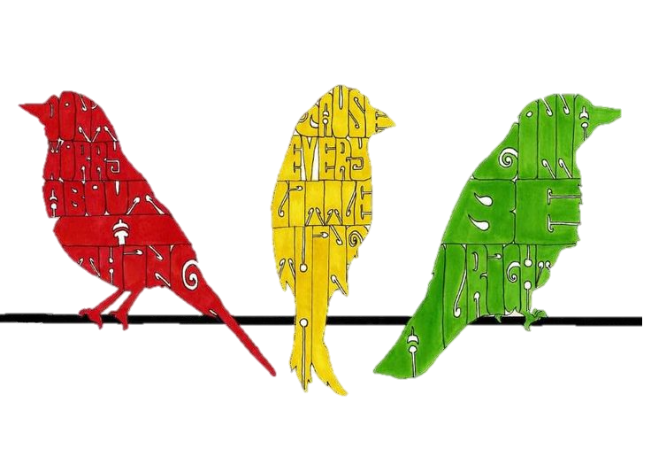
"Three Little Birds"
"Don't worry about a thing
'Cause every little thing gonna be all right
Singin': "Don't worry about a thing
'Cause every little thing gonna be all right!"
Rise up this mornin'
Smile with the risin' sun
Three little birds
Pitch by my doorstep
Singin' sweet songs
Of melodies pure and true
Sayin', ("This is my message to you-ou-ou")

Slide 91
"Three Little Birds"
Singin': "Don't worry 'bout a thing
'Cause every little thing gonna be all right"
Singin': "Don't worry (don't worry) 'bout a thing
'Cause every little thing gonna be all right!”
Singin': "Don't worry 'bout a thing
'Cause every little thing gonna be all right"
Singin': "Don't worry (don't worry) 'bout a thing
'Cause every little thing gonna be all right!"

Slide 92
"Three Little Birds"
Singin': "Don't worry about a thing, worry about a thing, oh!
Every little thing gonna be all right. Don't worry!"
Singin': "Don't worry about a thing" – I won't worry!
"'Cause every little thing gonna be all right"

Slide 93

Lean On Me
Sometimes in our lives
We all have pain, we all have sorrow.
But if we are wise,
We know that there's always tomorrow.
Lean on me when you're not strong
And I'll be your friend, I'll help you carry on
For it won't be long
'Til I'm gonna need somebody to lean on.
Please swallow your pride
If I have things you need to borrow
For no one can fill those of your needs
That you won't let show.
You just call on me, brother, when you need a hand
We all need somebody to lean on.
I just might have a problem that you'll understand,
We all need somebody to lean on.

Slide 94
Lean On Me
Lean on me when you're not strong
And I'll be your friend I'll help you carry on
For it won't be long
'Til I'm gonna need somebody to lean on
You just call on me, sister, when you need a hand
We all need somebody to lean on.
I just might have a problem that you'll understand,
We all need somebody to lean on.
If there is a load
You have to bear
That you can't carry
I'm right up the road
I'll share your load
If you just call me.

Slide 95
Lean On Me
Call me, call me
Call me, call meeeeeeeeeee

Slide 96
Fix You
When you try your best, but you don't succeed
When you get what you want, but not what you need
When you feel so tired, but you can't sleep
Stuck in reverse
And the tears come streaming down your face
When you lose something you can't replace
When you love someone, but it goes to waste
Could it be worse?
Lights will guide you home
And ignite your bones
And I will try to fix you

Slide 97
Fix You
And high up above or down below
When you're too in love to let it go
But if you never try you'll never know
Just what you're worth
Lights will guide you home
And ignite your bones
And I will try to fix you
Tears stream down your face
When you lose something you cannot replace
Tears stream down your face and I
Tears stream down your face
I promise you I will learn from my mistakes
Tears stream down your face and I

Slide 98
Fix You
Lights will guide you home
And ignite your bones
And I will try to fix you

Slide 99
Shotgun
Home grown alligator, see you later
Gotta hit the road, gotta hit the road
Something changed in the atmosphere
Architecture unfamiliar
I could get used to this
Time flies by in the yellow and green
Stick around and you'll see what I mean
There's a mountain-top that I'm dreamin' of
If you need me you know where I'll be

Slide 100
Shotgun
I'll be ridin' shotgun underneath the hot sun
Feelin' like a someone
I'll be ridin' shotgun underneath the hot sun
Feelin' like a someone
South of the Equator, navigator
Gotta hit the road, gotta hit the road
Deep sea divin' 'round the clock
Bikini bottoms, lager tops
I could get used to this
Time flies by in the yellow and green
Stick around and you'll see what I mean
There's a mountain-top that I'm dreamin' of
If you need me you know where I'll be

Slide 101
Shotgun
I'll be ridin' shotgun underneath the hot sun
Feelin' like a someone
I'll be ridin' shotgun underneath the hot sun
Feelin' like a someone
We got two in the front
Two in the back
Sailin' along
And we don't look back
(Back, back, back-back-back-back...)

Slide 102
Shotgun
Time flies by in the yellow and green
Stick around and you'll see what I mean
There's a mountain-top that I'm dreamin' of
If you need me you know where I'll be
I'll be ridin' shotgun underneath the hot sun
Feelin' like a someone
I'll be ridin' shotgun underneath the hot sun
Feelin' like a someone
I'll be ridin' shotgun underneath the hot sun
Feelin' like a someone
I'll be ridin' shotgun underneath the hot sun
Feelin' like a someone, a someone, a someone, a someone...

Slide 103
Ain't No Mountain High Enough
ain't no mountain high
Ain't no valley low, ain't no river wide enough, baby
If you need me, call me, no matter where you are
No matter how far,
Just call my name, I'll be there in a hurry
You don't have to worry
'Cause baby, there ain't no mountain high enough
Ain't no valley low enough, ain't no river wide enough
To keep me from getting to you, babe
Remember the day I set you free
I told you, you could always count on me,
And from that day on I made a vow
I'll be there when you want me some way, some how

Slide 104
Ain't No Mountain High Enough
ain't no mountain high enough
Ain't no valley low enough, ain't no river wide enough
To keep me from getting to you, babe
no wind, no rain
Or winters cold can stop me babe
baby, 'cause you are my love
oooooooohhhh oohhhhhhhh oooooaaaaahhh
oooooooohhhh oohhhhhhhh oooooaaaaahhh
oooooooohhhh oohhhhhhhh oooooaaaaahhh
ooooooooooooooooooooooooo

Slide 105
Ain't No Mountain High Enough
My love is alive, way down in my heart
Although we are miles apart
If you ever need a helping hand
I'll be there on the double just as fast as I can
ain't no mountain high enough
Ain't no valley low enough, ain't no river wide enough
To keep me from getting to you, baby
ain't no mountain high enough
Ain't no valley low enough, ain't no river wide enough
To keep me from getting to you, baaaaaaaaabe

Slide 106
Stand By Me
When the night has come
And the land is dark
And the moon is the only light we'll see
No, I won't be afraid
No, I won't be afraid
Just as long as you stand
Stand by me
So darlin', darlin', stand by me
Oh, stand by me
Oh, stand
Stand by me, stand by me
If the sky that we look upon
Should tumble and fall
Or the mountains should crumble to the sea
I won't cry, I won't cry
No I won't shed a tear
Just as long as you stand
Stand by me

Slide 107
Stand By Me
And darlin', darlin', stand by me
Oh, stand by me
Oh, stand now
Stand by me, stand by me
And darlin', darlin', stand by me
Oh, stand by me
Oh, stand now
Stand by me, stand by me
Whenever you're in trouble won't you stand by me
Oh, stand by me
Won't you stand by

Slide 108
Three Little Birds
Lean On Me
Fix You
Shotgun
Aint No Mountain High Enough
1/12/22 – 11am- 3.30

Slide 109
"Higher Love"
Think about it
There must be a higher love
Down in the heart
Or hidden in the stars above
Without it
Life is a wasted time
Look inside your heart
And I'll look inside mine
Things look so bad everywhere
In this whole world, what is fair
We walk the line and try to see
Falling behind in what could be, oh, oh

Slide 110
"Higher Love"
Bring me a higher love
Bring me a higher love, oh
Bring me a higher love
Where's that higher love I keep thinking of
Bring me higher love, love
Bring me higher love, oh
Bring me higher love, love
Bring me a higher love
Bring me higher love, love
Bring me higher love, oh
Bring me higher love, love
Bring me a higher love

Slide 111
"Higher Love"
Worlds are turning
And we're just hanging on
Facing our fear
And standing out there alone
A yearning, yeah
And it's real to me
There must be someone
Who's feeling for me
Things look so bad everywhere
In this whole world, what is fair
We walk the line and try to see
Falling behind in what could be, oh, ooh

Slide 112
"Higher Love"
Bring me a higher love
Bring me a higher love, oh
Bring me a higher love
Where's that higher love I keep thinking of
Bring me higher love, love
Bring me higher love, oh
Bring me higher love, love
Bring me a higher love
Bring me higher love, love
Bring me higher love, oh
Bring me higher love, love
Bring me a higher love

Slide 113
”It’s a Sin"
When I look back upon my life
It's always with a sense of shame
I've always been the one to blame
For everything I long to do
No matter when or where or who
Has one thing in common, too
[Chorus]
It's a, it's a, it's a, it's a sin
It's a sin
Everything I've ever done
Everything I ever do
Every place I've ever been
Everywhere I'm going to
It's a sin
[Verse 2]
At school they taught me how to be
So pure in thought and word and deed
They didn't quite succeed
For everything I long to do
No matter when or where or who
Has one thing in common, too
[Chorus]

Slide 114
”It’s a Sin"
So I look back upon my life
Forever with a sense of shame
I've always been the one to blame
Mmmm
For everything I long to do
No matter when or where or who
Has one thing in common, too
[Chorus]
It's a, it's a, it's a, it's a sin
It's a sin
Everything I've ever done
Everything I ever do
Every place I've ever been
Everywhere I'm going to
It's a sin

Slide 115
” Together in Electric Dreams"
[Verse 1]
I only knew you for a while
I never saw your smile
'Til it was time to go
Time to go away
(Time to go away)
[Verse 2]
Sometimes it's hard to recognize
Love comes as a surprise
And it's too late
It's just too late to stay
Too late to stay
[Chorus]
We'll always be together
However far it seems
(Love never ends)
We'll always be together
Together in electric dreams

Slide 116
” Together in Electric Dreams"
[Verse 3]
Because the friendship that you gave
Has taught me to be brave
No matter where I go
I'll never find a better prize
(Find a better prize)
[Verse 4]
Though you're miles and miles away
I see you every day
I don’t have to try
I just close my eyes
I close my eyes
[Chorus]
We'll always be together
However far it seems
(Love never ends)
We'll always be together
Together in electric dreams
We'll always be together
However far it seems
(Love never ends)
We'll always be together
Together in electric dreams
[Instrumental Interlude]
[Outro]
We'll always be together
However far it seems
(Love never ends)
We'll always be together
Together in electric dreams
We'll always be together
However far it seems
(Love never ends)
We'll always be together
Together in electric dreams...

Slide 117
” Born This Way"
My mama told me when I was young, "We are all born superstars"
She rolled my hair and put my lipstick on in the glass of her boudoir
"There's nothing wrong with loving who you are"
She said, "'Cause He made you perfect, babe
So hold your head up, girl, and you'll go far"
Listen to me when I say
I'm beautiful in my way
'cause God makes no mistakes
I'm on the right track, baby, I was born this way
Don't hide yourself in regret, just love yourself, and you're set
I'm on the right track, baby, I was born this way (born this way)
Ooh, there ain't no other way, baby, I was born this way
Baby, I was born this way (born this way)
Ooh, there ain't no other way, baby, I was born this way
Right track, baby, I was born this way
-Break-

Slide 118
” Born This Way"
Don't be a drag, just be a queen
Whether you're broke or evergreen
You're Black, white, beige, chola descent
You're Lebanese, you're Orient'
Whether life's disabilities left you outcast, bullied, or teased
Rejoice and love yourself today
'Cause, baby, you were born this way
Break-
No matter gay, straight, or bi', lesbian, transgender life
I'm on the right track, baby, I was born to survive
No matter Black, white or beige, chola, or Orient' made
I'm on the right track, baby, I was born to be brave
I'm beautiful in my way 'cause God makes no mistakes
I'm on the right track, baby, I was born this way
Don't hide yourself in regret, just love yourself, and you're set
I'm on the right track, baby, I was born this way
-Break-

Slide 119
” Born This Way"
Ooh, there ain't no other way, baby, I was born this way
Baby, I was born this way (born this way)
Ooh, there ain't no other way, baby, I was born this way
Baby, I was born this way (born this way)
I was born this way, hey
I was born this way, hey
I'm on the right track, baby, I was born this way, hey
I was born this way, hey
I was born this way, hey
I'm on the right track, baby, I was born this way, hey

Slide 120
” Born This Way"
Introduction

Slide 121
” Born This Way"
My mama told me when I was young, "We are all born superstars"
She rolled my hair and put my lipstick on in the glass of her boudoir
"There's nothing wrong with loving who you are"
She said, "'Cause He made you perfect, babe
So hold your head up, girl, and you'll go far"
Listen to me when I say

Slide 122
” Born This Way"
I'm beautiful in my way
'cause God makes no mistakes
I'm on the right track, baby, I was born this way
Don't hide yourself in regret, just love yourself, and you're set
I'm on the right track, baby, I was born this way (born this way)
Ooh, there ain't no other way, baby, I was born this way
Baby, I was born this way (born this way)
Ooh, there ain't no other way, baby, I was born this way
Right track, baby, I was born this way

Slide 123
” Born This Way"
Break

Slide 124
” Born This Way"
Don't be a drag, just be a queen
Whether you're broke or evergreen
You're Black, white, beige, chola descent
You're Lebanese, you're Orient'
Whether life's disabilities left you outcast, bullied, or teased
Rejoice and love yourself today
'Cause, baby, you were born this way

Slide 125
” Born This Way"
Break

Slide 126
” Born This Way"
No matter gay, straight, or bi', lesbian, transgender life
I'm on the right track, baby, I was born to survive
No matter Black, white or beige, chola, or Orient' made
I'm on the right track, baby, I was born to be brave
I'm beautiful in my way 'cause God makes no mistakes
I'm on the right track, baby, I was born this way
Don't hide yourself in regret, just love yourself, and you're set
I'm on the right track, baby, I was born this way

Slide 127
” Born This Way"
Break

Slide 128
” Born This Way"
No matter gay, straight, or bi', lesbian, transgender life
I'm on the right track, baby, I was born to survive
No matter Black, white or beige, chola, or Orient' made
I'm on the right track, baby, I was born to be brave
I'm beautiful in my way 'cause God makes no mistakes
I'm on the right track, baby, I was born this way
Don't hide yourself in regret, just love yourself, and you're set
I'm on the right track, baby, I was born this way

Slide 129
” Born This Way"
Break

Slide 130
” Born This Way"
Ooh, there ain't no other way, baby, I was born this way
Baby, I was born this way (born this way)
Ooh, there ain't no other way, baby, I was born this way
Baby, I was born this way (born this way)
I was born this way, hey
I was born this way, hey
I'm on the right track, baby, I was born this way, hey
I was born this way, hey
I was born this way, hey
I'm on the right track, baby, I was born this way, hey

Slide 131

Glow & Grow
First we’ll reflect on what’s going well at choir sessions and our latest performance. (“Glow”)
Then have a think about and what we can develop (“Grow”).
Share how you’re finding things, and any suggestions for how the leaders can support you in new ways?
Prefer to stay anonymous, use your orange slips and put your thoughts in the (Not Orange) Box at the side.
🎉 Bunting Review
If you’ve made any bunting at KACCL, we’ll review it together!

Slide 132
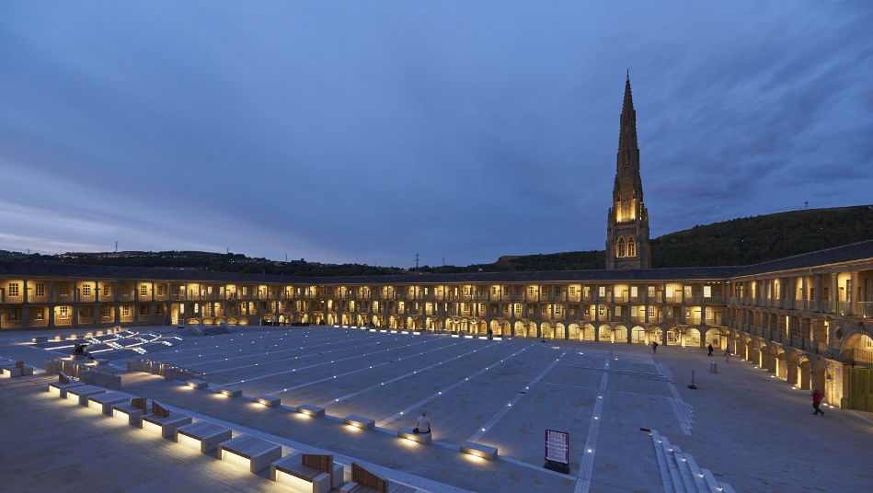
Something Inside
All About You
Three Little Birds/One Love
Merry Xmas (Slade) 15mins
A Little Respect
Lean On Me
Tender
Merry Xmas Everyone
Rocking Around
Sat 14th Dec
11.15am
Meet at Square Chapel Café at 10.45
🎶 Performance Prep
We’ll also get our songs polished and ready for Saturday morning’s performance!

